Slide 1
Git Basics
Git is a popular version control system. It was created by Linus Torvalds in 2005, and has been maintained by Junio Hamano since then.
Abhay R Kamath
Data Scientist Intern

Slide 2
Version Control
A version control system, or VCS, tracks the history of changes as people and teams collaborate on projects together. As developers make changes to the project, any earlier version of the project can be recovered at any time.
Developers can review project history to find out:
Which changes were made?
Who made the changes?
When were the changes made?
Why were changes needed?
Notes:
Version control is a system that records changes to a file or set of files over time so that you can recall specific versions later. So ideally, we can place any file in the computer on version control.

Slide 3
So What is Git?
Git is a version control system.
Git helps you keep track of code changes.
Git is used to collaborate on code.
Git also helps you synchronise code between multiple people.
Notes:
Git is a Distributed Version Control System, does not rely on a central server to store all the versions of a project’s files, instead every user “clones” a copy of a repository which has all of the metadata of the original while the original itself is stored on a self-hosted server or a third party hosting service like GitHub.

Slide 4
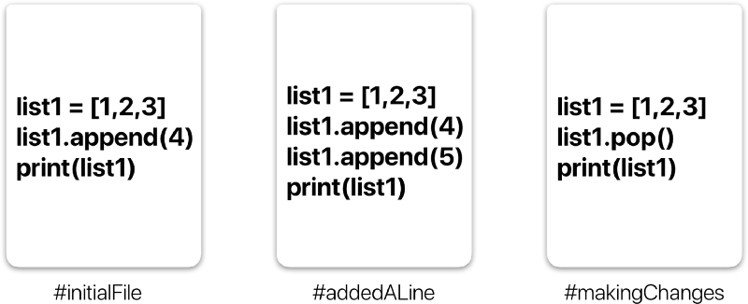
A simple example of version history of a file.

Slide 5
Git Workflow
A repository a.k.a. repo is nothing but a collection of source code.
There are four fundamental elements in the Git Workflow.
1) Working Directory
2) Staging Area
3) Local Repository
4) Remote Repository.

Slide 6
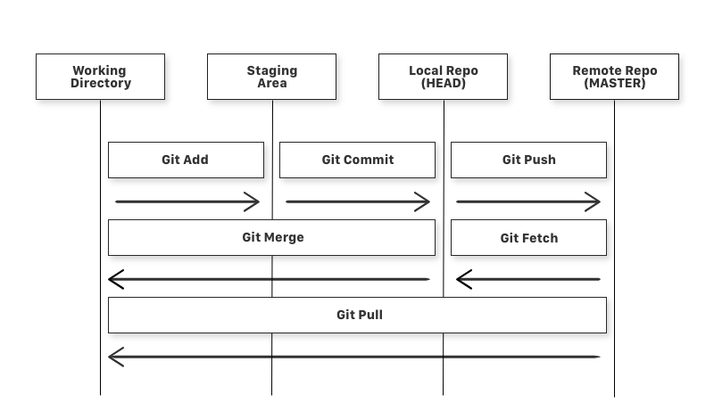
Diagram of a simple Git Workflow

Slide 7
Commands
git add
git commit
git push
git fetch
git merge
git pull
Notes:
git add is a command used to add a file that is in the working directory to the staging area.
git commit is a command used to add all files that are staged to the local repository.
git push is a command used to add all committed files in the local repository to the remote repository. So in the remote repository, all files and changes will be visible to anyone with access to the remote repository.
git fetch is a command used to get files from the remote repository to the local repository but not into the working directory.
git merge is a command used to get the files from the local repository into the working directory.
git pull is command used to get files from the remote repository directly into the working directory. It is equivalent to a git fetch and a git merge

